Slide 1
Chapter 9
How to work with dates and strings

Slide 2
Objectives
Applied
Given the date-handling requirements of an application, write the code that satisfies the requirements.
Given the string-handling requirements of an application, write the code that satisfies the requirements.
Given the formatting requirements of an application, use the Format() method of the String class or interpolated strings to provide the formatting.
Knowledge
Describe the way a DateTime variable is stored.
Explain how a String object differs from a StringBuilder object.
Explain what happens if you enable nullable reference types for your project.

Slide 3
The syntax for creating a DateTime value
DateTime variableName = new DateTime(year, month, day
[, hour, minute, second[, millisecond]]);
How to create a DateTime value using the Parse() method
DateTime variableName = DateTime.Parse(string);
How to create a DateTime value using the TryParse() method
DateTime.TryParse(string, out DateTime variableName);

Slide 4
Statements that create DateTime values
DateTime startDate =
new DateTime(2020, 01, 30); // 1/30/2020 12:00 AM
DateTime startDateAndTime =
new DateTime(2020, 1, 30, 14, 15, 0); // 1/30/2020 2:15 PM
DateTime startDate =
DateTime.Parse("01/30/20"); // 1/30/2020 12:00 AM
DateTime startDateAndTime
= DateTime.Parse("Jan 30, 2020 2:15 PM"); // 1/30/2020 2:15 PM
DateTime invoiceDate = DateTime.Parse(txtInvoiceDate.Text);
DateTime.TryParse(txtInvoiceDate.Text, out DateTime invoiceDate);

Slide 5
Valid date formats
01/30/2020
1/30/20
01-01-2020
1-1-20
2020-01-01
Jan 30 2020
January 30, 2020
Valid time formats
2:15 PM
14:15
02:15:30 AM

Slide 6
DateTime properties for getting the current date and time
Property Description
Now Returns the current date and time.
Today Returns the current date.
Statements that get the current date and time
DateTime currentDateTime = DateTime.Now; // 1/30/2020 4:24:59 AM
DateTime currentDate = DateTime.Today; // 1/30/2020 12:00:00 AM

Slide 7
DateTime methods for formatting a date or time
Method Description
ToLongDateString() Converts the DateTime value to a string that includes the name for the day of the week, the name for the month, the day of the month, and the year.
ToShortDateString() Converts the DateTime value to a string that includes the numbers for the month, day, and year.
ToLongTimeString() Converts the DateTime value to a string that includes the hours, minutes, and seconds.
ToShortTimeString() Converts the DateTime value to a string that includes the hours and minutes.

Slide 8
Statements that format dates and times
string longDate = currentDateTime.ToLongDateString(); // Thursday, January 30, 2020
string shortDate = currentDateTime.ToShortDateString(); // 1/30/2020
string longTime = currentDateTime.ToLongTimeString(); // 4:24:59 AM
string ShortTime = currentDateTime.ToShortTimeString(); // 4:24 AM

Slide 9
Properties for working with dates and times
Date
Month
Day
Year
Hour
Minute
Second
TimeOfDay
DayOfWeek
DayOfYear
Methods for working with dates and times
DaysInMonth(year, month)
IsLeapYear(year)

Slide 10
Statements that get information about a date or time
DateTime currentDateTime = DateTime.Now; // 1/30/2020 10:26:35 AM
int month = currentDateTime.Month; // 1
int hour = currentDateTime.Hour; // 10
int dayOfYear = currentDateTime.DayOfYear; // 30
int daysInMonth = DateTime.DaysInMonth(2019, 2); // 28
bool isLeapYear = DateTime.IsLeapYear(2019); // false

Slide 11
Code that uses the DayOfWeek property and enumeration
DayOfWeek dayOfWeek = currentDateTime.DayOfWeek;
string message = "";
if (dayOfWeek == DayOfWeek.Saturday ||
dayOfWeek == DayOfWeek.Sunday)
{
message = "Weekend";
}
else
{
message = "Weekday";
}

Slide 12
Methods for performing operations on dates and times
AddDays(days)
AddMonths(months)
AddYears(years)
AddHours(hours)
AddMinutes(minutes)
AddSeconds(seconds)
Add(timespan)
Subtract(datetime)

Slide 13
Statements that perform operations on dates and times
DateTime dateTime =
DateTime.Parse("3/1/2020 13:28"); // 3/1/2020 1:28:00 PM
DateTime dueDate = dateTime.AddMonths(2); // 5/1/2020 1:28:00 PM
dueDate = dateTime.AddDays(60); // 4/30/2020 1:28:00 PM
DateTime runTime = dateTime.AddMinutes(30); // 3/1/2020 1:58:00 PM
runTime = dateTime.AddHours(12); // 3/2/2020 1:28:00 AM

Slide 14
Code that results in a TimeSpan value
DateTime currentDate = DateTime.Today; // 1/30/2020
dueDate = DateTime.Parse("2/15/2020"); // 2/15/2020
TimeSpan timeTillDue =
dueDate.Subtract(currentDate); // 16:00:00:00
int daysTillDue = timeTillDue.Days; // 16
Description
A TimeSpan value represents a period of time stored as ticks. You can use the Days, Hours, Minutes, and Seconds properties of a TimeSpan value to get portions of that value.

Slide 15
A statement that uses the - operator to subtract two dates
TimeSpan timeTillDue = dueDate - currentDate; // 16:00:00:00
An if statement that uses the > operator on DateTime values
bool pastDue = false;
if (currentDate > dueDate)
pastDue = true;

Slide 16
Common properties of the String class
[index]
Length
Code that uses an index to access a character in a string
string chars = "abcdefg";
char a = chars[0]; // 'a'
char b = chars[1]; // 'b'

Slide 17
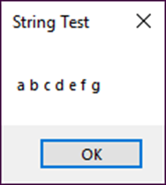
Code that uses a for loop to access each character in the string
string charsAndSpaces = "";
for (int i = 0; i < chars.Length; i++)
charsAndSpaces += chars[i] + " ";
MessageBox.Show(charsAndSpaces, "String Test");
The message box that’s displayed
Code that uses a foreach loop to access each character in the string
string charsAndSpaces = "";
foreach (char c in chars)
charsAndSpaces += c + " ";
MessageBox.Show(charsAndSpaces, "String Test");

Slide 18
Common methods of the String class
StartsWith(string)
EndsWith(string)
IndexOf(string[, startIndex])
LastIndexOf(string[, startIndex])
Insert(startIndex, string)
PadLeft(totalWidth)
PadRight(totalWidth)
Remove(startIndex, count)
Replace(oldString, newString)
Substring(startIndex[, length])
ToLower()
ToUpper()
Trim()
Split(splitCharacters)

Slide 19
Code that uses the StartsWith() and EndsWith() methods
bool startsWithABC = chars.StartsWith("abc"); // true
bool endsWithABC = chars.EndsWith("abc"); // false
Code that uses the IndexOf() and LastIndexOf() methods
string companyName = "Mike Murach and Associates";
int index1 = companyName.IndexOf(" "); // 4
int index2 = companyName.IndexOf(' '); // 4
int index3 = companyName.IndexOf("Inc."); // -1
int index4 = companyName.LastIndexOf(" "); // 15

Slide 20
Code that uses the Remove(), Insert(), and Replace() methods
companyName = companyName.Remove(0, index1 + 1);
companyName = companyName.Insert(companyName.Length, ", Inc.");
companyName = companyName.Replace("and", "And");
// Murach And Associates, Inc.
Code that uses the Substring(), ToUpper(), and ToLower() methods
string firstName = "anne";
string firstLetter = firstName.Substring(0, 1).ToUpper();
string otherLetters = firstName.Substring(1).ToLower();
firstName = firstLetter + otherLetters; // Anne
Code that copies one string to another string
string s1 = "abc";
string s2 = s1; // this copies the value stored in s1 to s2
s2 = "def"; // this doesn't change the value stored in s1

Slide 21
Code that parses a first name from a name string
string fullName = " Edward C Koop "; // " Edward C Koop "
fullName = fullName.Trim(); // "Edward C Koop"
int firstSpace = fullName.IndexOf(" "); // 6
string firstName = "";
if (firstSpace == -1)
firstName = fullName;
else
firstName = fullName.Substring(0, firstSpace); // Edward

Slide 22
Code that parses a string that contains an address
string address = " |805 Main Street|Dallas|TX|12345| ";
address = address.Trim();
if (address.StartsWith("|"))
address = address.Remove(0, 1);
if (address.EndsWith("|"))
address = address.Remove(address.Length - 1, 1);
int cityIndex = address.IndexOf("|") + 1;
int stateIndex = address.IndexOf("|", cityIndex) + 1;
int zipIndex = address.IndexOf("|", stateIndex) + 1;
string street = address.Substring(0, cityIndex - 1);
string city = address.Substring(
cityIndex, stateIndex - cityIndex - 1);
string state = address.Substring(
stateIndex, zipIndex - stateIndex - 1);
string zipCode = address.Substring(zipIndex);

Slide 23
Code that uses the Split() method to parse the name string
string fullName = " Edward C Koop ";
fullName = fullName.Trim();
string[] names = fullName.Split(' ');
string firstName = names[0]; // Edward
Code that uses the Split() method to parse the address string
address = address.Trim();
if (address.StartsWith("|"))
address = address.Remove(0, 1);
string[] columns = address.Split('|');
string street = columns[0]; // 805 Main Street
string city = columns[1]; // Dallas
string state = columns[2]; // TX
string zipCode = columns[3]; // 12345

Slide 24
Code that adds hyphens to a phone number
string phoneNumber = "9775551212";
phoneNumber = phoneNumber.Insert(3, "-");
phoneNumber = phoneNumber.Insert(7, "-");
// 977-555-1212
Code that replaces the hyphens in a date with slashes
string date = "12-27-2018";
date = date.Replace("-", "/"); // 12/27/2018

Slide 25
The syntax of the Parse() and TryParse() methods for validating decimal values
Parse(string, style1[ | style2]...)
TryParse(string, style1[ | style2]..., formatProvider, result)
Common members of the NumberStyles enumeration for decimal values (part 1)
Member Characters allowed
AllowCurrencySymbol Digits and a $ sign
AllowDecimalPoint Digits and a decimal point
AllowLeadingWhiteSpace Digits and leading whitespace
AllowTrailingWhiteSpace Digits and trailing whitespace
AllowLeadingSign Digits and a leading sign
AllowTrailingSign Digits and a trailing sign

Slide 26
Common members of the NumberStyles enumeration for decimal values (part 2)
AllowParentheses Parentheses around the digits to indicate a negative value
AllowThousands Digits and commas used as thousands separators
Currency Digits and all of the characters listed above
Number Digits and all of the characters listed above except for a $ sign and parentheses
None Digits only

Slide 27
A Parse() method that allows entries with any valid decimal characters
decimal invoiceTotal =
Decimal.Parse(txtTotal.Text, NumberStyles.Currency);
A TryParse() method that allows entries with a $ sign and a decimal point
Decimal.TryParse(txtTotal.Text,
NumberStyles.AllowCurrencySymbol |
NumberStyles.AllowDecimalPoint,
CultureInfo.CurrentCulture, out decimal invoiceTotal);

Slide 28
How to enable nullable reference types at the project level
In the Solution Explorer, right-click on the project name and select Properties.
Select the Build Category.
From the Nullable drop-down list, select Enable.
How to enable nullable reference types at the file level
#nullable enable
using System.Windows.Forms;
.
.
.

Slide 29
How to declare a nullable reference type
string? message = null;
How to check that a variable isn’t null
if (message != null)
int length = message.Length;

Slide 30
A statement that may display a null warning
int length = message.Length;
How to stop a warning from being displayed
int length = message!.Length;
Common situations when warnings are displayed
When you assign or pass a null value to a non-nullable reference type.
When you assign or pass a nullable reference type to a non-nullable one.
When you refer to a nullable reference type that may be null.
When a non-nullable field of a new object isn’t initialized to a non-null value.

Slide 31
The syntax for creating a StringBuilder object
StringBuilder variableName =
new StringBuilder([value][,][capacity]);
Statements that create and initialize StringBuilder objects
StringBuilder address1 = new StringBuilder(); // Capacity is 16
StringBuilder address2 = new StringBuilder(10); // Capacity is 10
StringBuilder phoneNumber1 =
new StringBuilder("9775551212"); // Capacity is 16
StringBuilder phoneNumber2 =
new StringBuilder("9775551212", 10); // Capacity is 10
A statement that simplifies references to the StringBuilder class
using System.Text;

Slide 32
Common properties of the StringBuilder class
[index]
Length
Capacity
Common methods of the StringBuilder class
Append(string)
Insert(index, string)
Remove(startIndex, count)
Replace(oldString, newString)
ToString()

Slide 33
Code that creates a phone number and inserts dashes
StringBuilder phoneNumber = new StringBuilder(10); // Capacity is 10
phoneNumber.Append("9775551212"); // Capacity is 10
phoneNumber.Insert(3, "."); // Capacity is 20
phoneNumber.Insert(7, "."); // 977.555.1212
phoneNumber.Remove(0, 4); // 555.1212
phoneNumber.Replace(".", "-"); // 555-1212
lblPhoneNumber.Text = phoneNumber.ToString(); // 555-1212

Slide 34
The syntax of the Format() method of the String class
Format(string, value1[, value2]...)
The syntax of a format specification within the string argument
{N[, M][:formatString]}
Explanation
N An integer that indicates the value to be formatted.
M The width of the formatted value as an integer. If M is negative, the value will be left-justified. If it’s positive, it will be right-justified.
formatString A string of formatting codes.
The syntax of a format string
positiveformat[;negativeformat[;zeroformat]]

Slide 35
Standard numeric formatting codes
Code Description
C or c Formats the number as currency with the specified number of decimal places.
D or d Formats an integer with the specified number of digits.
E or e Formats the number in scientific (exponential) notation with the specified number of decimal places.
F or f Formats the number as a decimal with the specified number of decimal places.
G or g Formats the number as a decimal or in scientific notation depending on which is more compact.
N or n Formats the number with thousands separators and the specified number of decimal places.
P or p Formats the number as a percent with the specified number of decimal places.

Slide 36
Custom numeric formatting codes
Code Description
0 Zero placeholder
# Digit placeholder
. Decimal point
, Thousands separator
% Percentage placeholder
; Section separator

Slide 37
Statements that format a single number
string balance1 = String.Format("{0:c}", 1234.56); // $1,234.56
string balance2 = String.Format(
"{0:$#,##0.00;($#,##0.00)}", -1234.56); // ($1,234.56)
string balance3 =
String.Format("{0:$#,##0.00;($#,##0.00);Zero}", 0); // Zero
string quantity = String.Format("{0:d3}", 43); // 043
string payment = String.Format("{0:f2}", 432.8175); // 432.82
A statement that formats two numbers
string totalDue = String.Format(
"Invoice total: {0:c}; Amount due: {1:c}.", 354.75, 20);
// Invoice total: $354.75; Amount due: $20.00.

Slide 38
Standard DateTime formatting codes
Code Description
d Short date
D Long date
f Long date, short time
F Long date, long time
t Short time
T Long time
g Short date, short time
G Short date, long time

Slide 39
Custom DateTime formatting codes (part 1)
Code Description
d Day of the month without leading zeros
dd Day of the month with leading zeros
ddd Abbreviated day name
dddd Full day name
M Month without leading zeros
MM Month with leading zeros
MMM Abbreviated month name
MMMM Full month name
y Two-digit year without leading zero
yy Two-digit year with leading zero
yyyy Four-digit year
/ Date separator

Slide 40
Custom DateTime formatting codes (part 2)
Code Description
h Hour without leading zeros
hh Hour with leading zeros
H Hour on a 24-hour clock without leading zeros
HH Hour on a 24-hour clock with leading zeros
m Minutes without leading zeros
mm Minutes with leading zeros
s Seconds without leading zeros
ss Seconds with leading zeros
f Fractions of seconds (one f for each decimal place)
t First character of AM/PM designator
tt Full AM/PM designator
: Time separator

Slide 41
Statements that use custom codes to format dates and times
DateTime currentDate = DateTime.Now; // 1/30/2020 10:37:32 PM
String.Format("{0:d}", currentDate) // 1/30/2020
String.Format("{0:D}", currentDate) // Thursday, January 30, 2020
String.Format("{0:t}", currentDate) // 10:37 PM
String.Format("{0:T}", currentDate) // 10:37:32 PM
String.Format("{0:ddd, MMM d, yyyy}", currentDate) // Thu, Jan 30, 2020
String.Format("{0:M/d/yy}", currentDate) // 1/30/20
String.Format("{0:HH:mm:ss}", currentDate) // 22:37:32

Slide 42
The basic syntax of an interpolated string
$string
The syntax of an interpolated expression within the string
{value[, M][:formatString]}
Explanation
value The value to be formatted.
M An integer that indicates the width of the formatted value. If M is negative, the value will be left-justified. If it’s positive, it will be right-justified.
formatString A string of numeric or DateTime formatting codes.

Slide 43
Statements that format numbers
string balance1 = $"{1234.56:c}"; // $1,234.56
string balance2 =
$"{-1234.56:$#,##0.00;($#,##0.00)}"; // ($1,234.56)
A statement that formats a date
string date1 = $"{DateTime.Now:D}";
// Thursday, October 08, 2020

Slide 44
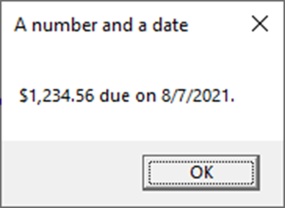
Code that formats a number and a date
decimal balanceDue = 1234.56m;
DateTime dateDue = new DateTime(2021, 08, 07);
MessageBox.Show($"{balanceDue:c} due on {dateDue:d}.",
"A number and a date");

Slide 45
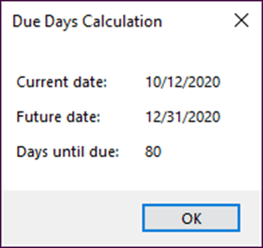
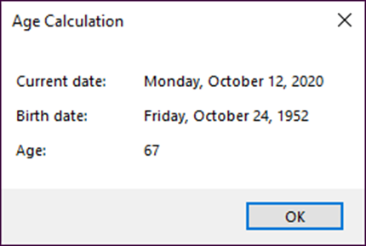
Exercise 9-1 Work with dates and times
Calculate the due days for a given future date.
Calculate the age for a given a birth date.

Slide 46
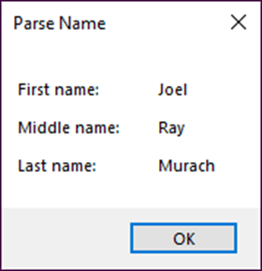
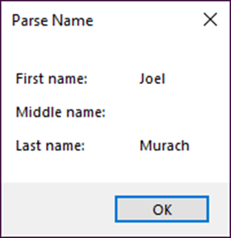
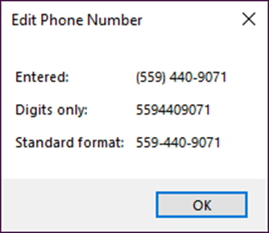
Exercise 9-2 Work with strings
Parse a name into first, middle, and last names.
Edit a phone number so it uses a standard format.

Slide 47
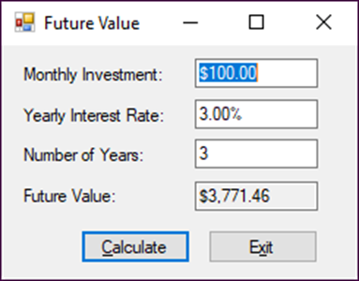
Exercise 9-3 Enhance the Future Value application
Use the Parse method to validate numeric entries.

Slide 48
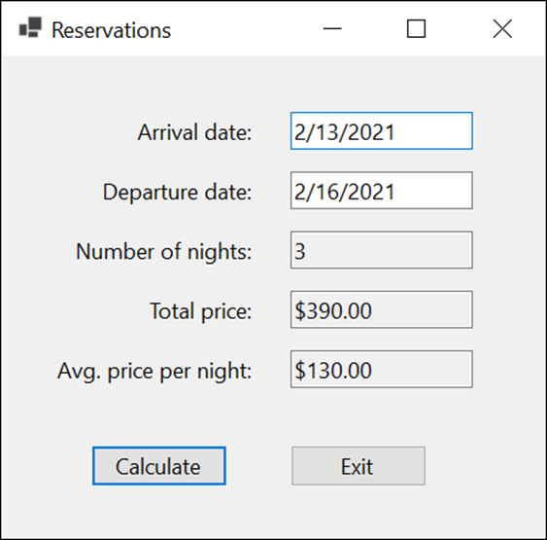
Extra 9-1 Calculate reservation totals
Calculate the Number of nights, total price, and average price for a reservation based on the arrival and departure dates.

Slide 49
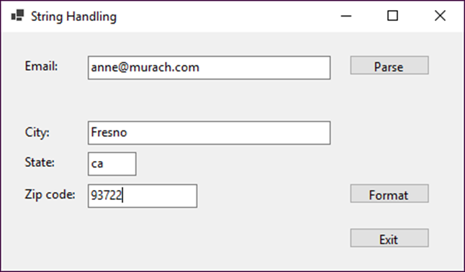
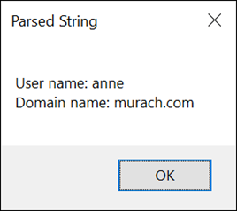
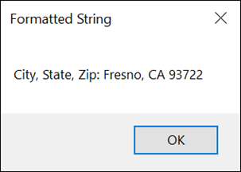
Extra 9-2 Work with strings
Parse an email address and format the city, state, and zip code portion of an address.

Slide 50
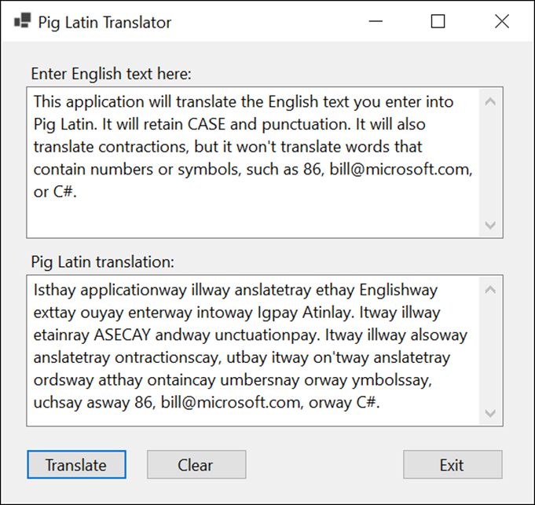
Project 2-1 Translate English to Pig Latin
Create a form that accepts a text entry and converts it to Pig Latin.

Slide 51
Objectives
Applied
Given the date-handling requirements of an application, write the code that satisfies the requirements.
Given the string-handling requirements of an application, write the code that satisfies the requirements.
Given the formatting requirements of an application, use the Format() method of the String class or interpolated strings to provide the formatting.
Knowledge
Describe the way a DateTime variable is stored.
Explain how a String object differs from a StringBuilder object.
Explain what happens if you enable nullable reference types for your project.

